Slide 1
Application Of Trigonometry

Slide 2
Math micro project
Roll NO. : 210451 Name : Abdurrahman Qureshi
Roll NO. : 210452 Name : Welder Umme Hafsa
Roll NO. : 210453 Name : Ansari Saad Mohd. Arif
Roll NO. : 210454 Name : Shaikh Azlan Ahmed
Roll NO. : 210455 Name : Qazi Mohd. Oaish

Slide 3
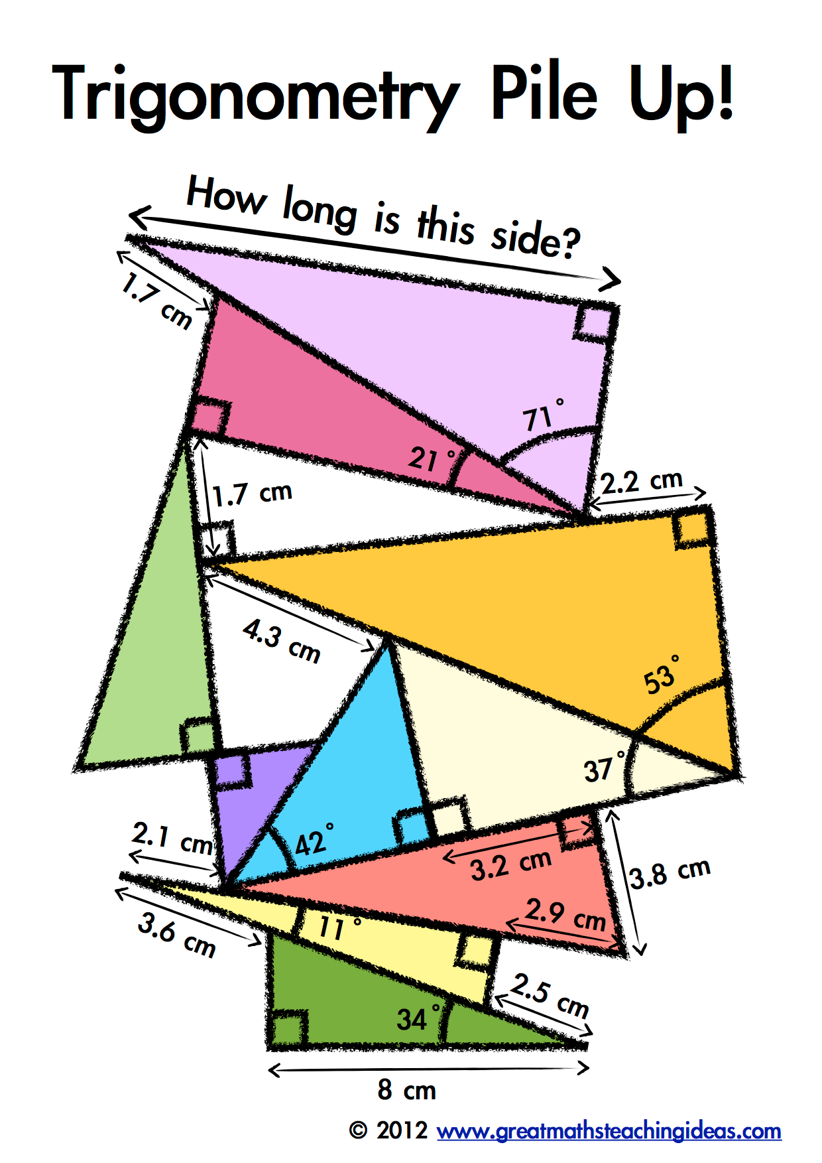
Definition
Trigonometry is derived from the Greek words “trigonon”-{three angle} and “metron”-{measure}.
Trigonometry is the branch of mathematics which deals with Triangles, particularly triangles in a plane where one angle of the triangle is 90 degrees.
Trigonometry specifically deals with the relationship between the sides and angles of triangle ,that is, on the trigonometric functions, and with calculations based on these function.

Slide 4
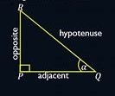
Origin
The origin of trigonometry can be traced to the civilization of Ancient Egypt ,Mesopotamia and Indus valley, more than 4000 years ago.
Some experts believe that, Trigonometry originally invented to calculate Sundials ,a tradition exercise in the oldest book.
The first recorded use of trigonometry came from the Hellenistic Mathematician “Hipparchus Circa” around 150 BC, who compiled a Trigonometry table using the Sine for solving triangles.

Slide 5
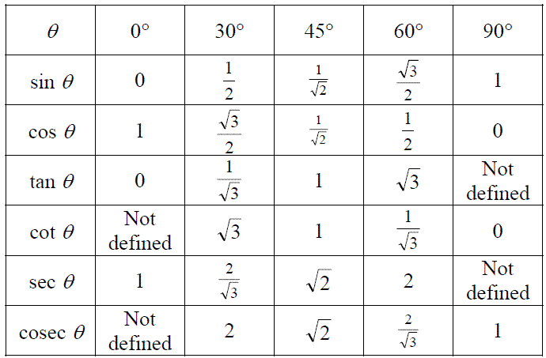
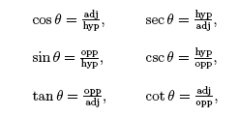
Trigonometric ratios
Trigonometric Ratios are the ratios of the certain parts of the right-angled triangle.
They are as follows:

Slide 6
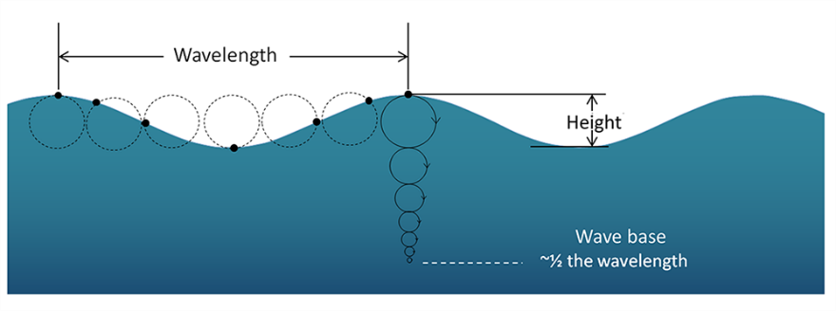

Application of trigonometry
Finding height & distances.
Used in Geology.
To build Architecture and construction.
In Oceanography.
For navigational purposes.

Slide 7
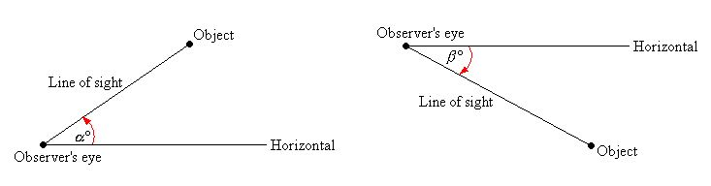
Height and distance
One of the main application of trigonometry is to find the distance between two or more places or to find the height of the object or the angle subtended by any object at a given point without actually measuring the distance or heights or angles.
Angle of elevation:- It is the angle made with the horizontal when the observer raises his eyes position.
Angle of depression:- It is the angle made with the horizontal when the observer lowers his eyes position.

Slide 8
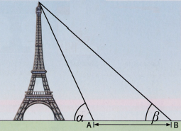
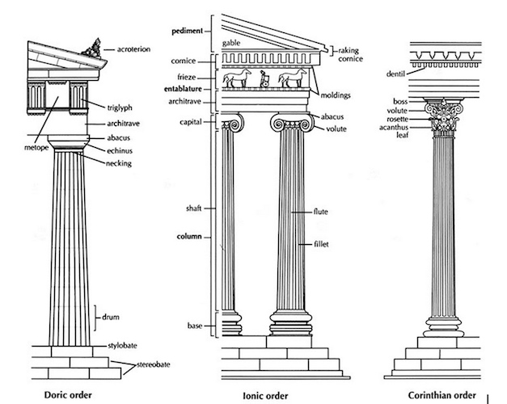
Architecture
Trigonometry is what helps the architects to calculate roof slopes, ground surfaces, light angles, structural loads , etc. of structures to design a mathematical draft that a constructor can use for construction purposes.
Trigonometry is used in architecture to ensure that buildings are built safely.

Slide 9


Navigation and Oceanography
Navigation: It is used in navigating the distance of the shore from a point in the sea.
Oceanography: It is used in calculating the heights of the tides formed in the ocean.

Slide 10

Astronomy
Astronomers use trigonometry to calculate how far stars and planets are from Earth. Even though we know the distances between planets and stars, this mathematical technique is also used by NASA scientists today when they design and launch space shuttles and rockets.

Slide 11

Geology
Trigonometry is used in geology to estimate the true dip of bedding angles. Calculating the true dip allows geologists to determine the slope stability.
Although not often regarded as an integral profession, geologists contribute to the safety of many building foundations.

Slide 12
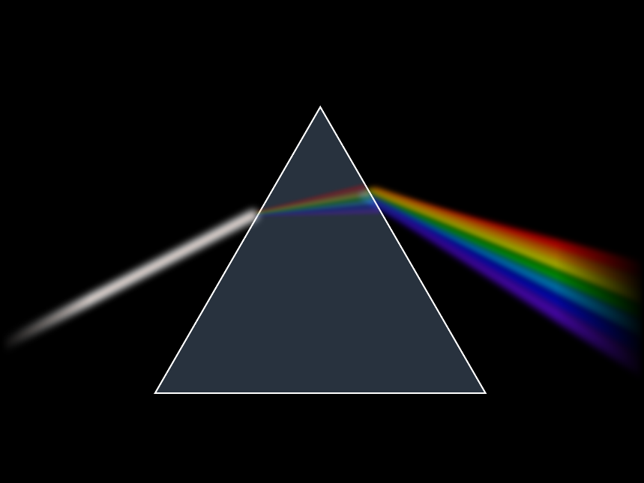

Physics
In physics, trigonometry is used to find the components of vectors, model the mechanics of waves (both physical and electromagnetic) and oscillations, sum the strength of fields, and use dot and cross products.
Even in projectile motion you have a lot of application of trigonometry.

Slide 13

Marine biology
Trigonometry is often used by marine biologists for measurements to figure out the depth of sunlight that affects algae to photosynthesis.
Using the trigonometric function and mathematical models, marine biologists estimate the size of larger animals like whales and also understand their behaviors.

Slide 14
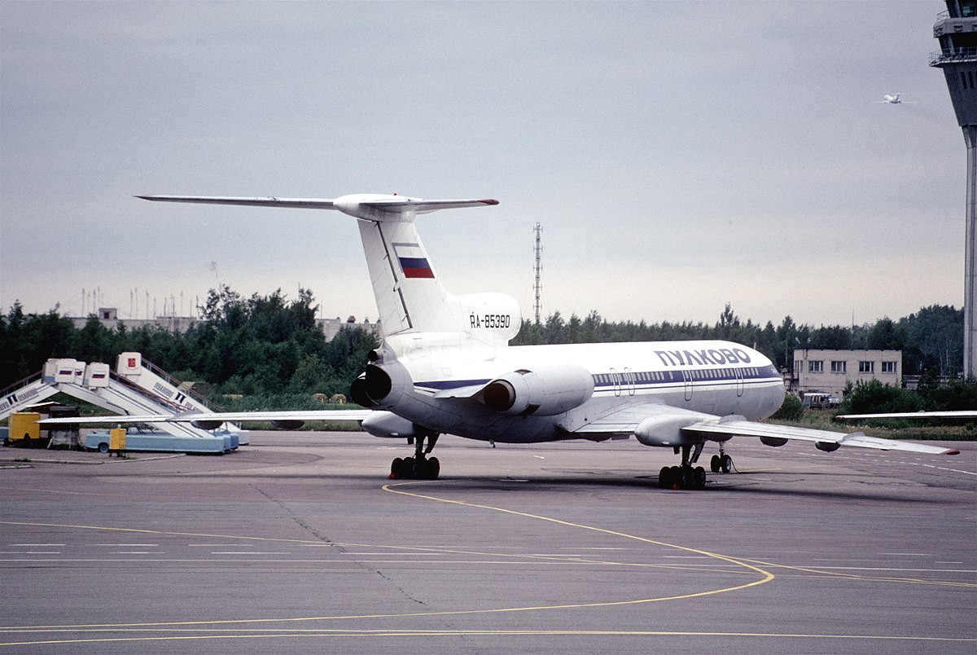
Aviation
It has taken into account the speed, direction and distance as well as the speed and direction of the wind.
The wind plays a vital role in when and how a flight will travel. This equation can be solved by using trigonometry.

Slide 15
Formulas
By using a right-angled triangle as a reference, the trigonometric functions and identities are derived:
sin θ = Opposite Side/Hypotenuse
cos θ = Adjacent Side/Hypotenuse
tan θ = Opposite Side/Adjacent Side
sec θ = Hypotenuse/Adjacent Side
cosec θ = Hypotenuse/Opposite Side
cot θ = Adjacent Side/Opposite Sid

Slide 16
identities
There are three Pythagorean trigonometric identities in trigonometry that are based on the right-triangle theorem or Pythagoras theorem.
sin² a + cos² a = 1
1+tan² a = sec² a
cosec² a = 1 + cot² a

